Slide 1
Examining and Predicting the Unemployment Rate
Connor Vaughan

Slide 2
Why is this important?
Understanding the Unemployment Rate is important to the FED, policymakers, and businesses because it is a good proxy for macroeconomic conditions
Examining the Unemployment Rate by demographic can help determine which demographics are impacted most by recessions
Being able to predict where the unemployment rate is going helps guide monetary and fiscal policy

Slide 3
Methodology
Data was gathered from Bureau of Labor Statistics
R was to analyze the data and create descriptive statistics, shown on the following slide
Plots were created to compare similar demographics using GGPlot2
Forecasting was done using the forecasting package and the ARIMA forecasting models

Slide 4
Descriptive Statistics
Demographic | Mean | Min | Max
Women | 6.35 | 3.6 | 10.4
Men | 6.30 | 3.6 | 11.2
Black | 11.97 | 5.9 | 21.2
Hispanic | 8.82 | 4.4 | 15.7
White | 5.54 | 3.3 | 9.7
Asian | 4.78 | 2.2 | 8.4
16-19 | 17.86 | 12 | 27.2
20-24 | 10.30 | 6.5 | 17.2
25-34 | 6.22 | 3.5 | 11
35-44 | 4.67 | 2.4 | 9
45-54 | 4.14 | 2.1 | 8.1
55 & Over | 3.93 | 2.3 | 7.4

Slide 5


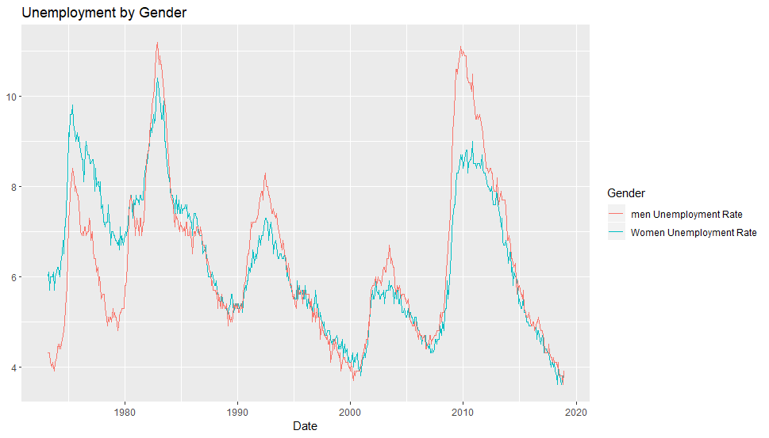




Slide 6
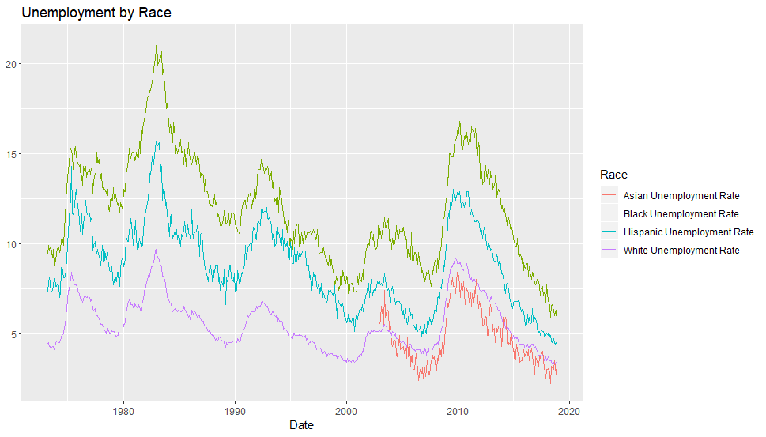

Slide 7
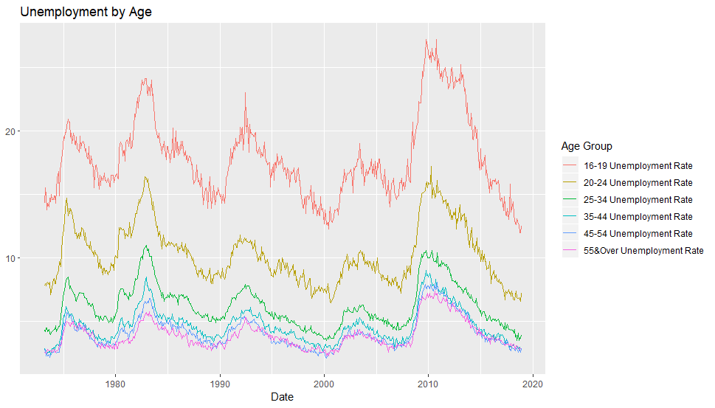

Slide 8
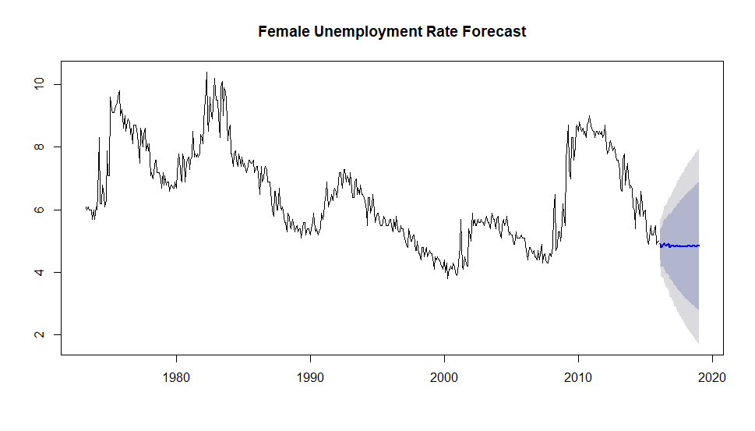
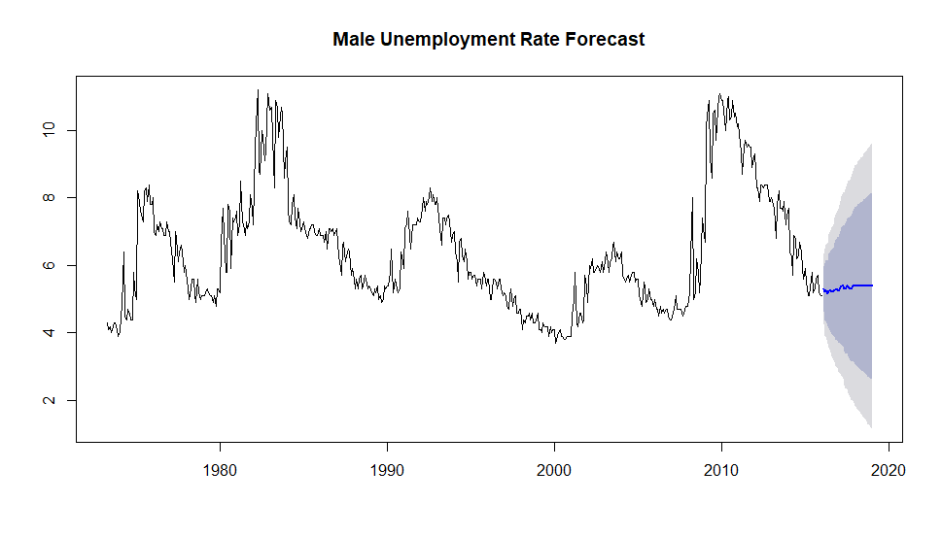

Slide 9
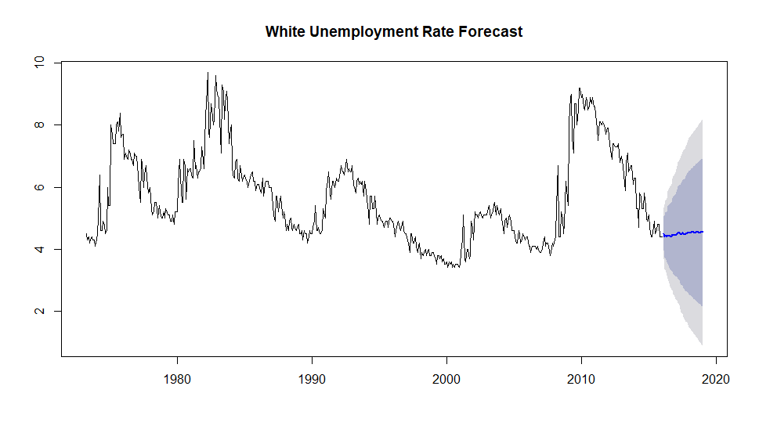
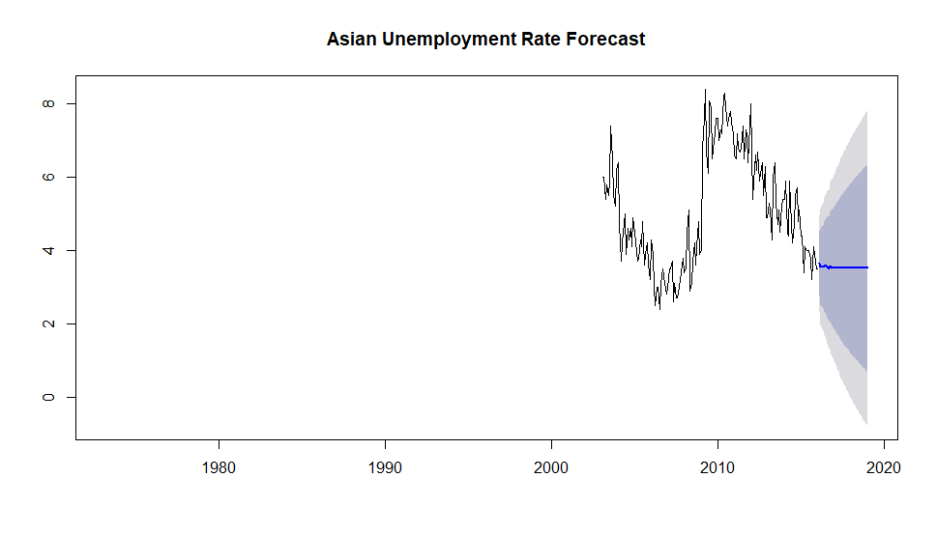
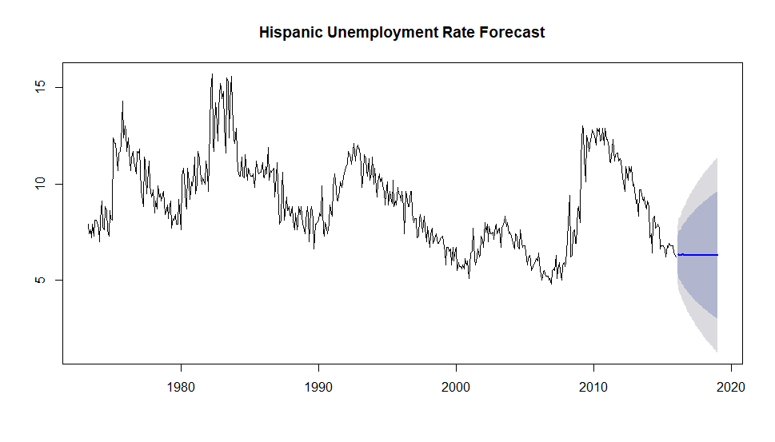
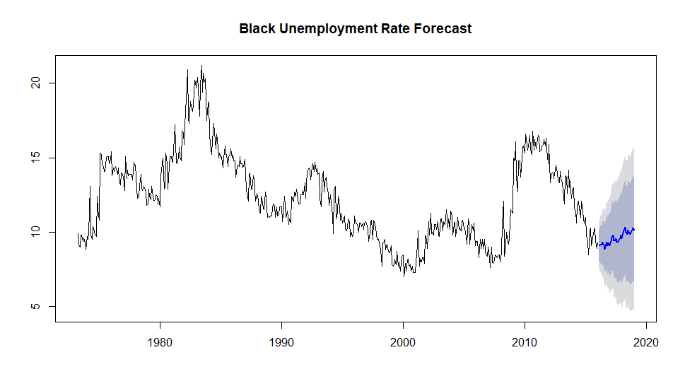

Slide 10
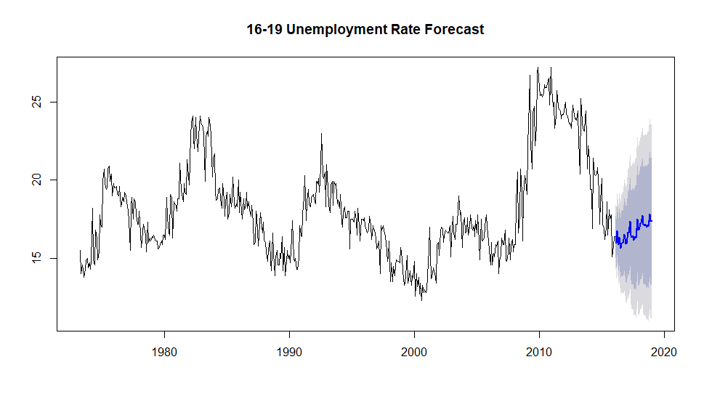
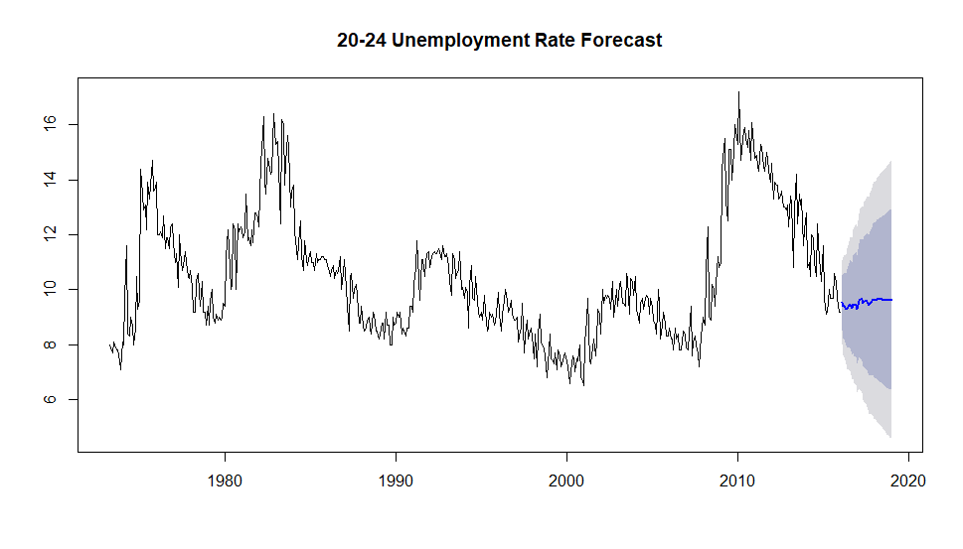
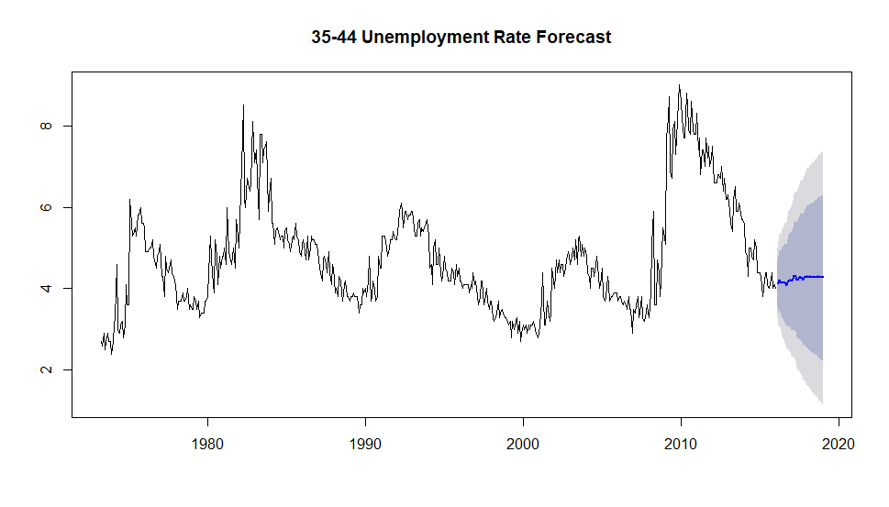
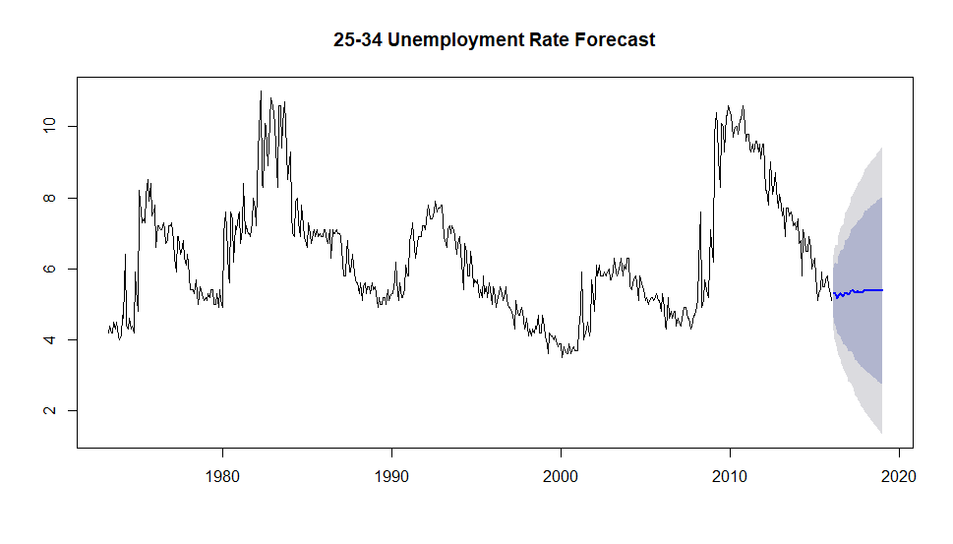

Slide 11
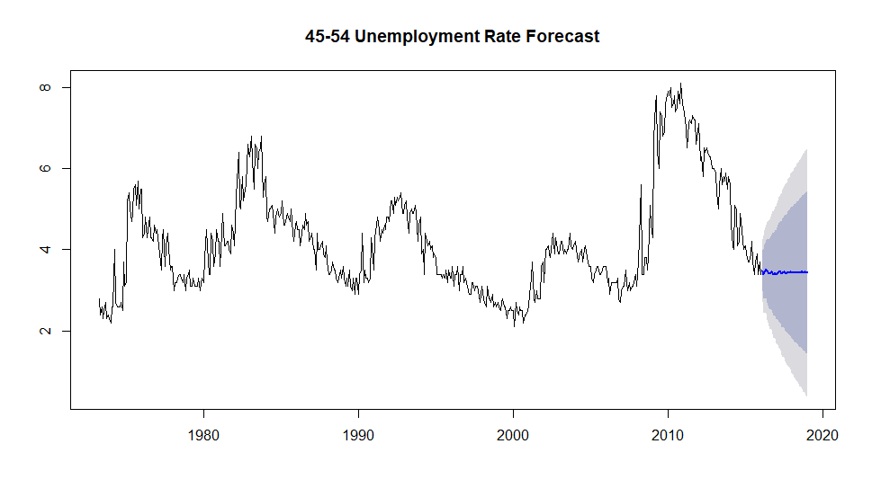
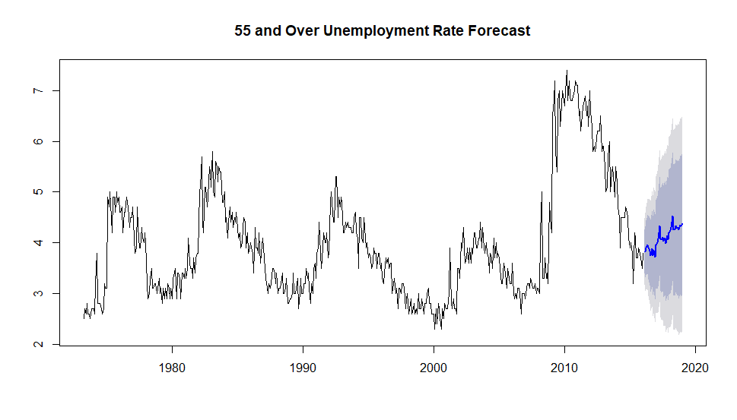

Slide 12
Challenges
Wrangling the data was difficult because the datasets were in formats I had not used before
For example the Asian demographic had a lot of missing data which prevented me from merging it with the rest of the data frame so I had to find a different function
I solved most my issues by troubleshooting online
I had not learned any forecasting techniques prior to this project so I had to read a lot about different forecasting methods

Slide 13
Conclusion
This model predicts that the unemployment rate will rise across all demographics over the following months
This forecast does overfit the training model
The model could be improved by incorporating the recessions into the training data

